Slide 1

Data analytics for SME in retail
Olga SHAVRINA
DAFT112021
11/02/2022

Slide 2
Business case
My client is a SME operating in Russia in jewellery industry (production and distribution via proper network (22 stores) in Saint-Petersburg.
Company does not have data analytics culture in order to manage business (except static revue of revenue per shop / per month without further analysis).
In that context, client would like to have (i) better understanding of underlying business drivers, (ii) sales forecast model for further period, (iii) monthly dashboard in order to adjust production as well as (iv) predictive model to determine a success of an item.

Slide 3

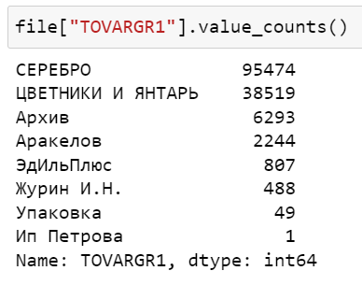
Data collection and storing
Data is sourced from internal software representing sales per day per item per shop from 2016-2019.
It englobes 2 main business lines (silver and fantasy necklaces). Silver represent c. 66% of sales. Our analysis is focused on silver business line.

Slide 4
Data cleaning pipeline
Main modifications concerned:
Reduce a number of individual article code (SKU) by splitting and creating new columns (17244>3600)
Dropping non-recurring items (customized orders) (c. 1k rows, i.e. 1%)
Dropping items related to shops that were closed with very low sales
Cut the dataset based on price range and qunatity range.
Data encoding based on LabelEncoder Method

Slide 5
EDA – TABLEAU Demo

Slide 6
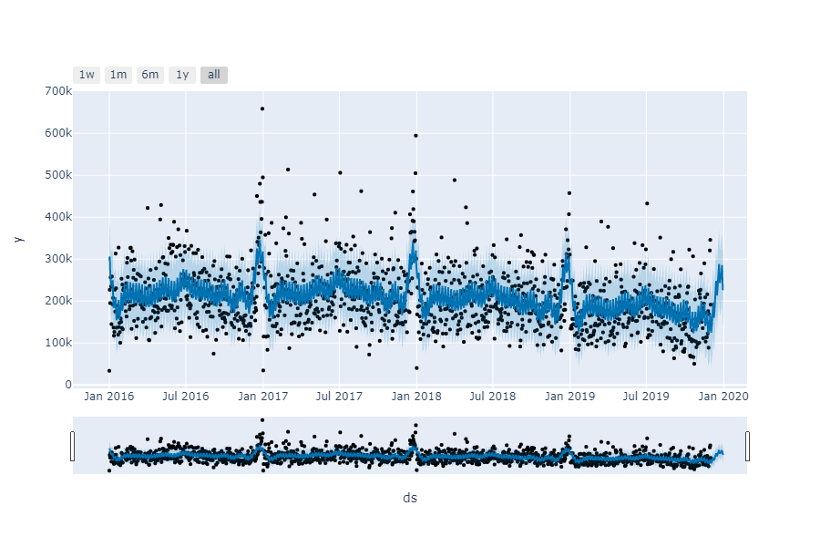
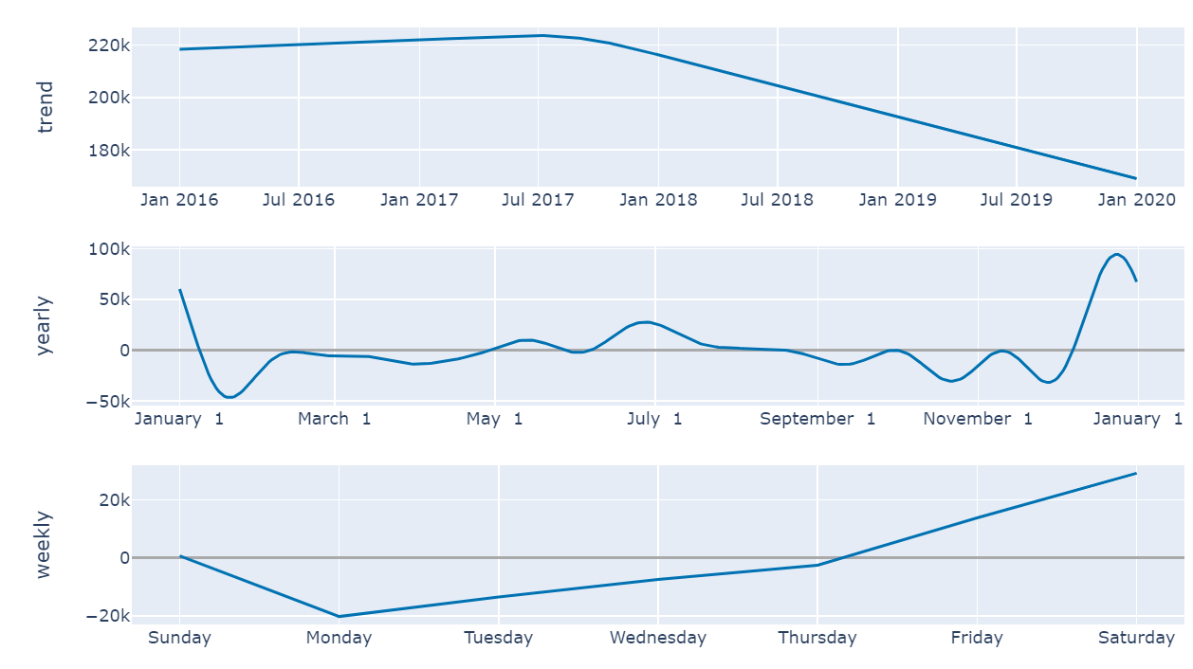
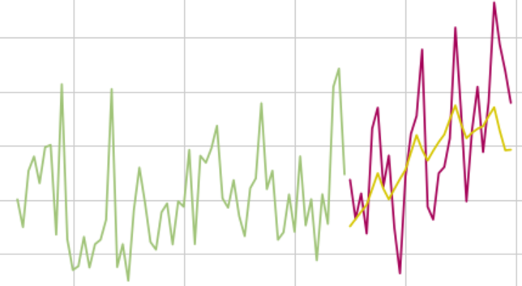
Results Forecast Model
Forecast: using of FB prophet library to construct a forecast for the next month (based on cross validation, mean absolution average error varies from 30% to 16%)
Forecast plot
Trends plot
Train test plot

Slide 7
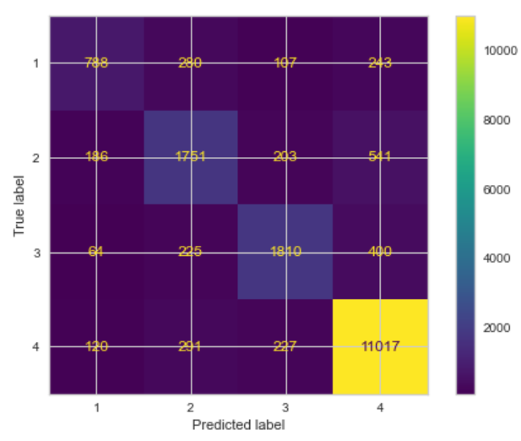
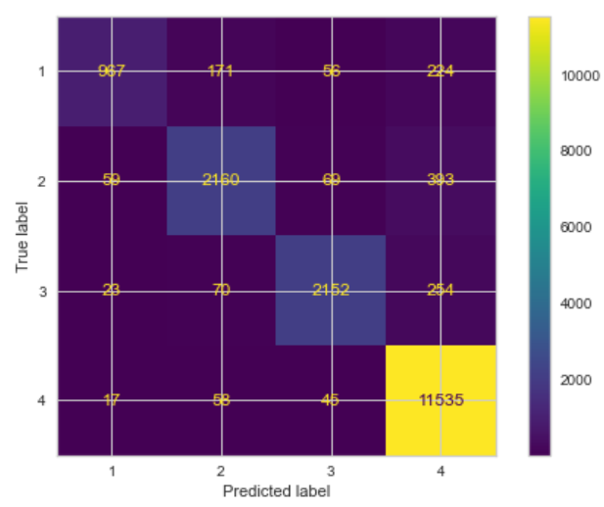

Model to predict a success of an item
Method : Supervised learning, random forest classifier with x={article, price and shop} and y=qty_range
Models used: (i) Random forect classifier (accuracy 84%), (ii)Kneighbours classifier (accuracy 78%), Logistic regression (accuracy:84%).
Method : Supervised learning, random forest classifier with x={article, price and shop} and y=qty_range
Models used: (i) Random forect classifier (n_est=200, accuracy 92%), (ii)Kneighbours classifier (n=20,accuracy 77%), Logistic regression (rs=0,accuracy:77%).

Slide 8
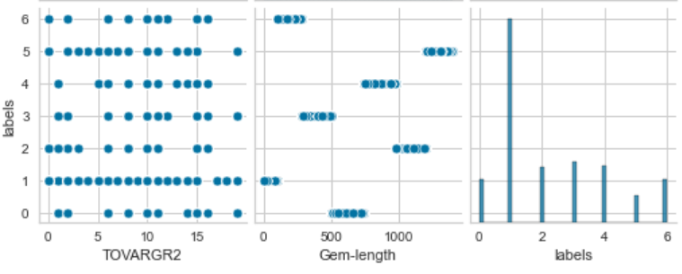
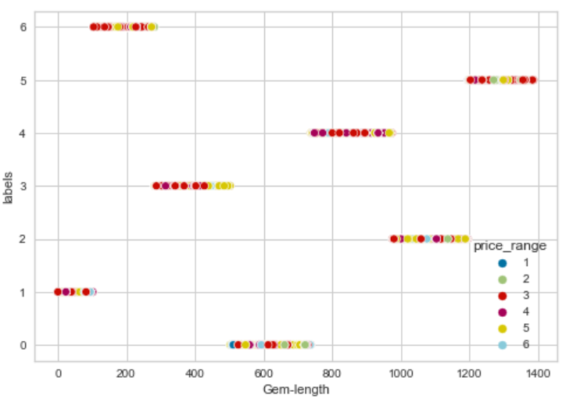
Unsupervised machine learning
Initially : We had hypothesis that there may be clustering based on the shop (mix across different shops)
Model used : KMeans excluding shop information.
Parameters: 7 clusters
Silhouette score: 69%

Slide 9
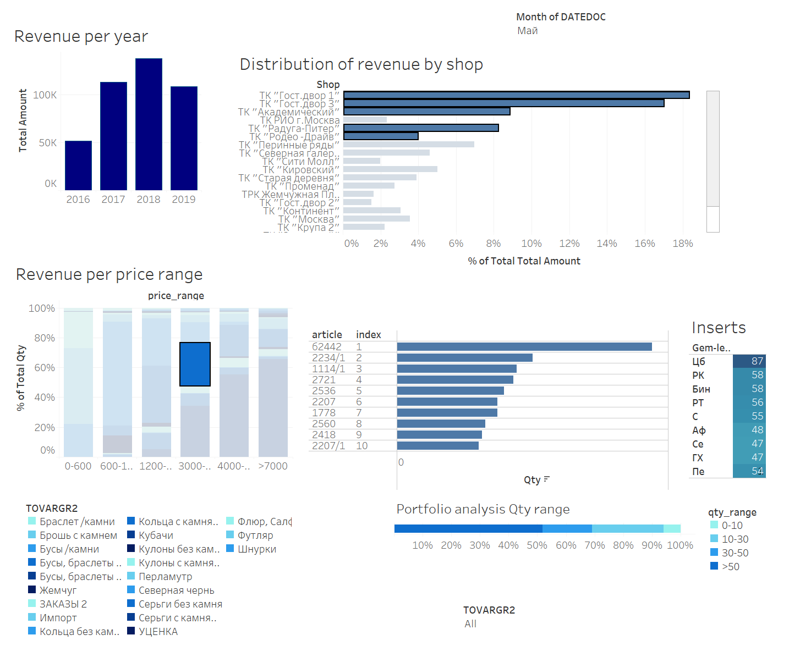
Tableau Dashboard

Slide 10
Business conclusion
Going forward, a success of an item can be predicted based on category, price, SKU and gem. Before launch a new SKU, the probability of success should be accessed via a model presented;
Rationalization of SKU mix as well as gems should be implemented;
There is no dependencies based on shop however there is a clustoring based on gems that needs to be investigated further.

Slide 11
Thank you.

